Slide 1



Nashville City Cemetery
1846-1979
Tigist Demeke

Slide 2

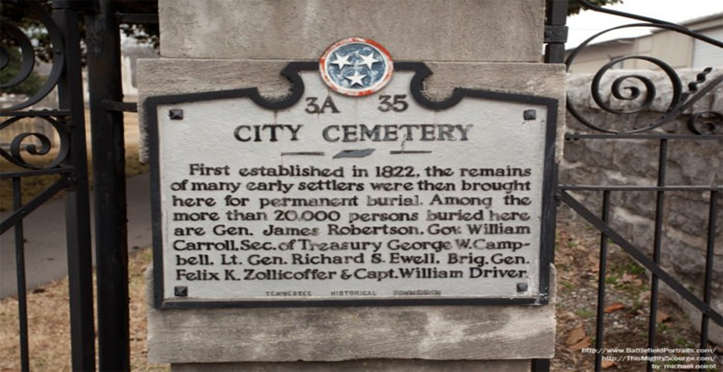



Nashville City Cemetery is the oldest public cemetery in Nashville, Tennessee. Many of Nashville's prominent historical figures are buried there. Nashville City Cemetery opened for burials in 1822 “public burial ground.”

Slide 3


Slide 4
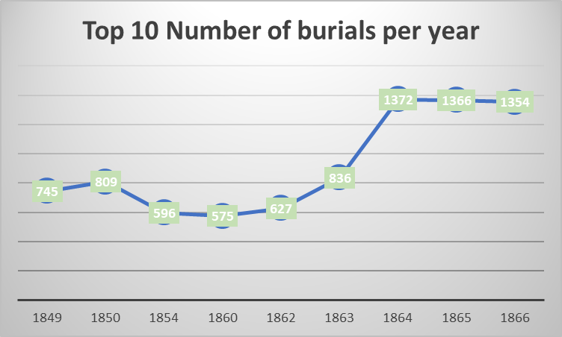
According to John Allyn, on his article mention the burial rate in 1864 was very high due to civil war.
For Civil War soldiers there were no “Good Deaths.” The Civil War resulted in 650,000 deaths overall.

Slide 5
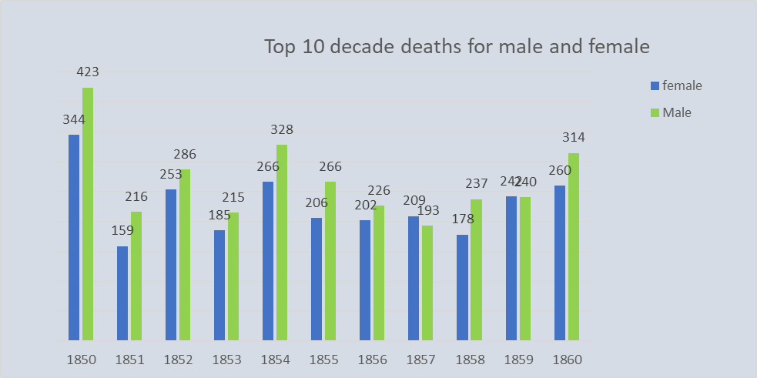

Slide 7
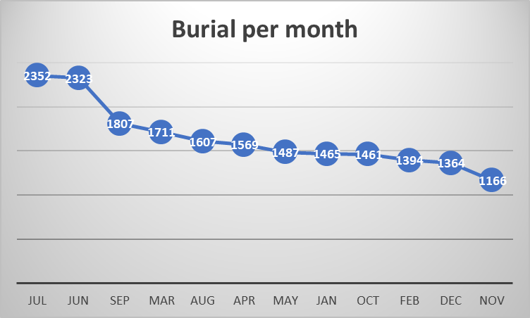

Slide 8


Slide 9
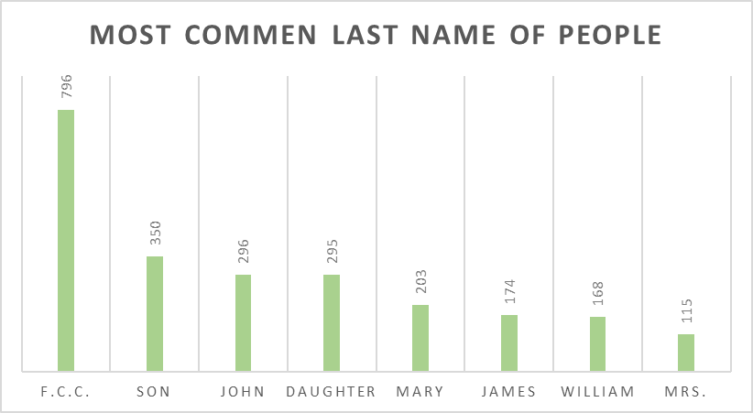
According to William Strickland Article “Among those interred in the cemetery are two of Nashville's founders, four Confederate generals, one Tennessee Governor, and twenty-two mayors of Nashville. ... Sea Captain William Driver, who coined the name "Old Glory" for his ship’s
U.S. Flag and hid that famous flag during the Civil War, is buried in Nashville city Cemetery.

Slide 10
Conclusion
Know the history
11.6 billion records for tracing your family tree.
Find cemetery, death, birth and marriage records.
Discover new connections with cemetery listings, military records and surname histories.
Great for beginner and advanced genealogists.

Slide 11
Nashville city Cemetery is located near downtown
Nashville at 1001 4th Avenue South
Thank you

